Slide 1
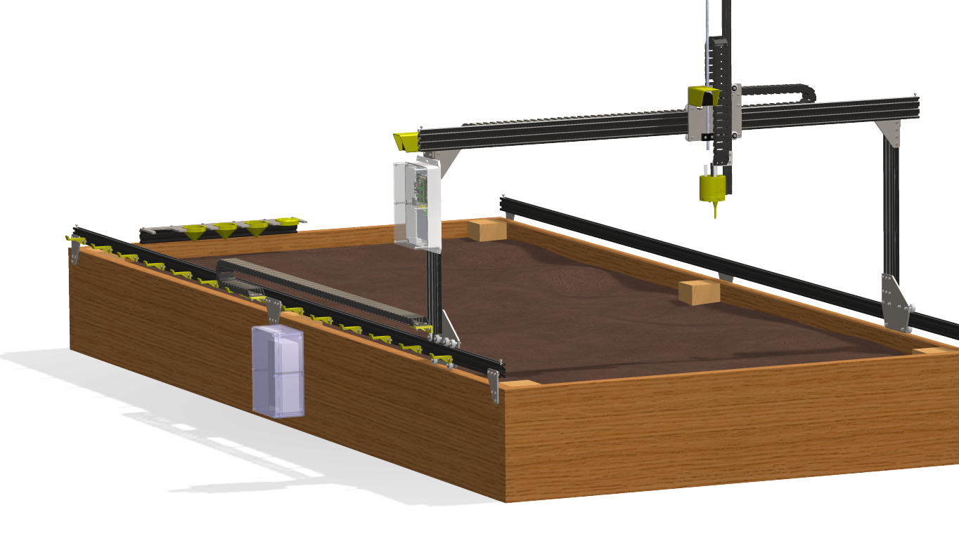
FarmBot
By Adanegbe Amadasun

Slide 2
Proposal
An open source automated farming device which operates similar to a 3D printer. But instead of extruding plastic, its tools are seed injectors, watering nozzles, sensors etc.
FarmBot will be able to perform the following task :
Monitor the temperature around the plant,
Provide light to the plant,
Check the moisture of the soil,
Also check the pH content of soil.

Slide 3
Budget
Raspberry Pi 3 Complete Starter Kit - 32 GB Edition - $74.35
Arduino Mega - $49.95
5v Switching Power Supply - $15
Ramps 1.4 for 3D Printer – $35.95
Stepper Motor Driver - $14.25
Bipolar Stepper Motor - $29.50
Time Pulley - $9.00
Rotary - $4.95
Timing Belt - $19
Total = $284.70 + HST

Slide 4
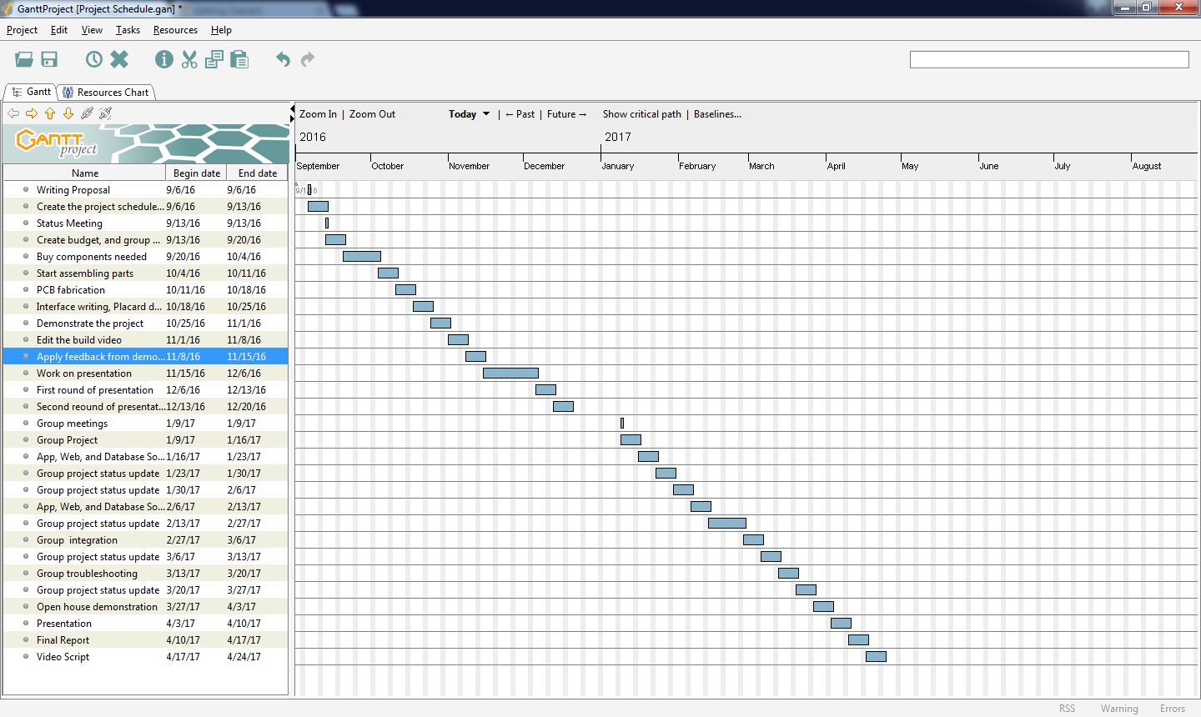
Schedule

Slide 5

Build Video

Slide 6
Previous Courses Utilized
CENG 252 - Embedded Systems
Provided knowledge on reading inputs from sensors.
CENG 200 - UNIX Scripting
Provided knowledge on scripting that I used as reference when creating my Python script.
WRIT 120 – Technical Reading and Writing Skills
Provided Knowledge on writing proposals and progress report
CENG 216 – Introduction to Software Engineering
Provided knowledge on creating schedule with gnat chart

Slide 7
The End

